Slide 1
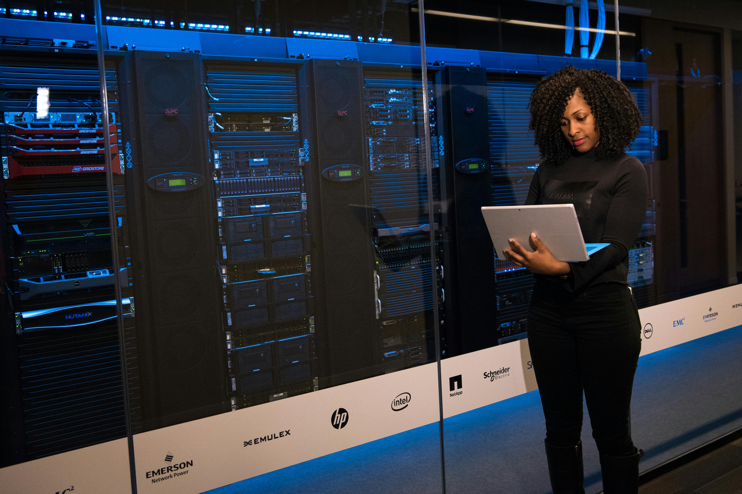
Client Pitch : Biometric Authentication Hardware

Slide 2
About us
BioSecure is a company that specializes in biometric authentication hardware. We provide first-class hardware-based security service for your company at the best price. We believe in responsive customer support and years of maintenance service. Now, you are secure.

Slide 3
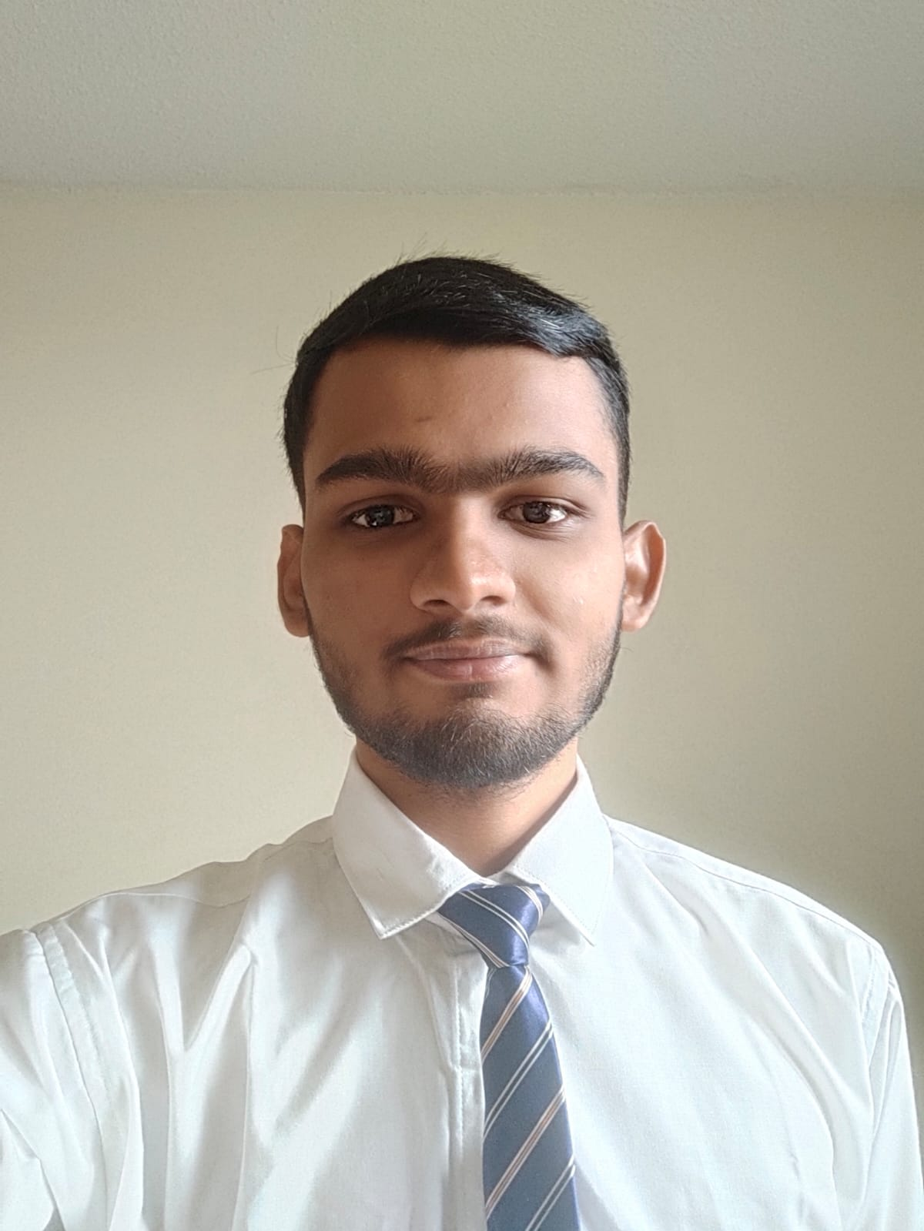
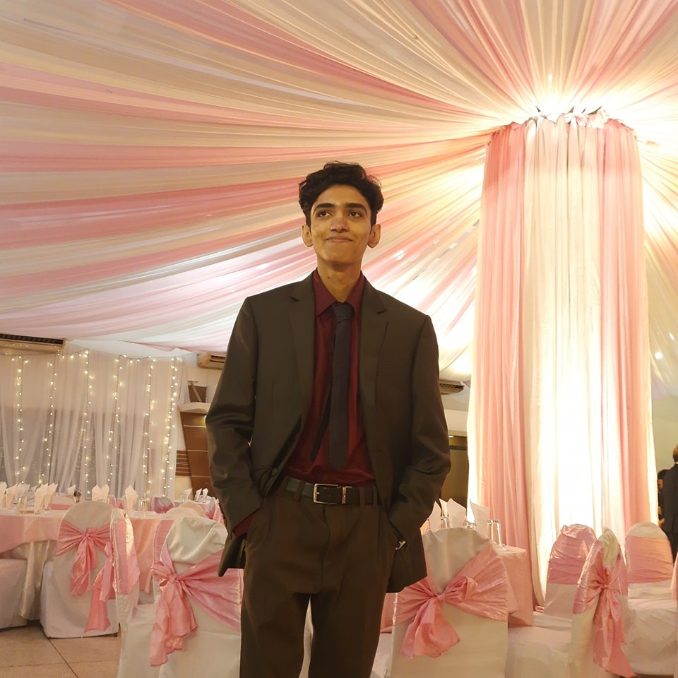
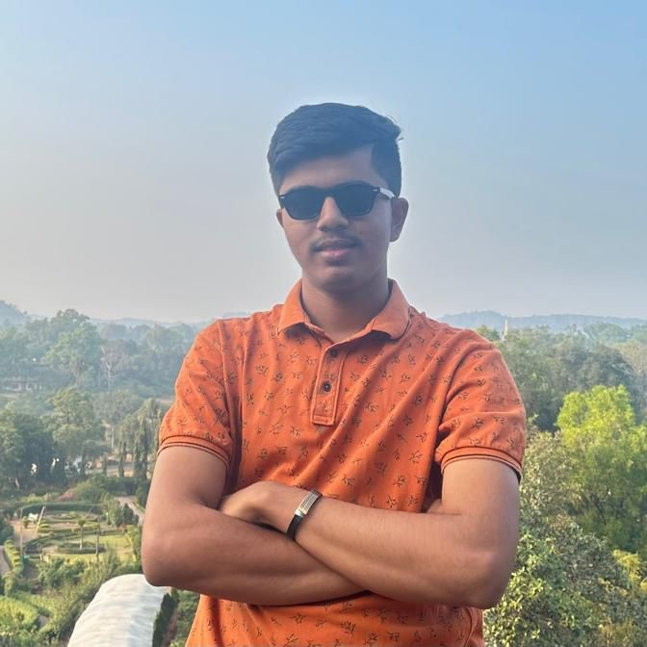
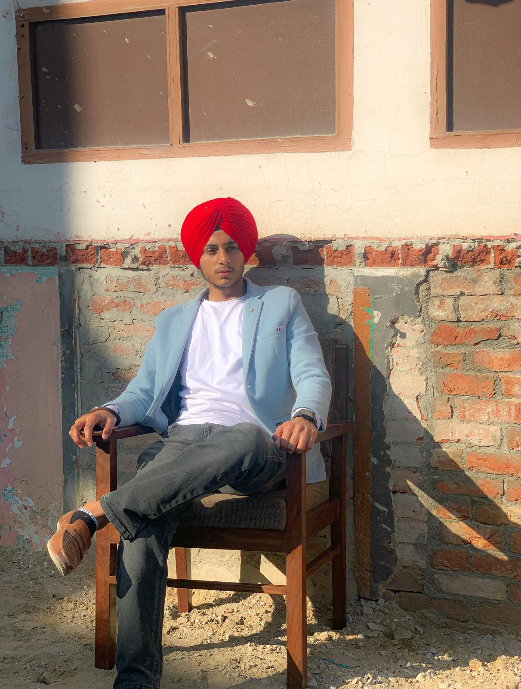
Meet the team
Vasukumar Patel
Sabit Naim
Chaitanya patel
Harpreet Singh
Founder and CEO
Co-Founder and CTO
Co-Founder and CFO
Co-Founder and CMO

Slide 4
Team expertise
Sabit Naim
VASUKUMAR PATEL
Responsible for the company's strategic direction and financial decisions.
Expertise in product development and software engineering.
Responsible for the company's setting technology strategy and innovation and R&D.
Expertise in project management and embedded software engineering.
Chaitanya patel
Responsible for the company's finance planning and budget management.
Expertise in financial analysis and planning and fintech.
HARPREET SINGH
Responsible for the company's marketing strategic planning
Expertise in digital marketing and brand management.

Slide 5
Why do you need Biometric Authentication Hardware?
Superior Security
No Fraud
Efficiency
In this fast-paced world, companies use high-end technologies like blockchain to secure their data, so why lack behind?
Nobody can steal your password and get into your account to steal important data, making you lose your job.
Biometric data is unique to everyone; therefore, no changing passwords or typing them.
Costs
Trust
Future-Proof
You will save more in the long-term using biometric devices, as there will be no cases of forgotten passwords.
Customers and employees expect their company to have better security with their data on board.
Moving forward, biometrics is the best way of authenticating, and it is compatible with emerging technologies.

Slide 6
Your MAJOR problems and our solutions
HIGH COST
2. SECURITY
HIGH COST
2. SECURITY
Our company's products are well equipped with the latest technology, such as artificial intelligence and blockchain, which our competitors do not offer even if you pay money.
Block Chain (Special Technology):
  Initially, it was only in the cryptocurrencies, but the tech model is also very useful in other areas to enhance security.
  Basically, it stores every piece of data in a cube called a lader, and every system has two keys, which are public and private.
  By using a model, it is impossible for anyone to decrypt your data.
  This technology provides you more security.
  In the market, only our company is offering this technology.
Our company believes in high-quality products at low prices.
Our price is less as compared to our competitors' price.
In market:
  Our competitors are offering services at 2000 CAD.
  We are offering our services for just 1500 CAD, which is less than 500 CAD.
  Bonus: Free installation and maintenance services, which you do not get if you take service from our competitors. By taking our services, your company will save a lot of money in the long term.
Our company's products are well equipped with the latest technology, such as artificial intelligence and blockchain, which our competitors do not offer even if you pay money.
Block Chain (Special Technology):
  Initially, it was only in the cryptocurrencies, but the tech model is also very useful in other areas to enhance security.
  Basically, it stores every piece of data in a cube called a lader, and every system has two keys, which are public and private.
  By using a model, it is impossible for anyone to decrypt your data.
  This technology provides you more security.
  In the market, only our company is offering this technology.
Our company believes in high-quality products at low prices.
Our price is less as compared to our competitors' price.
In market:
  Our competitors are offering services at 2000 CAD.
  We are offering our services for just 1500 CAD, which is less than 500 CAD.
  Bonus: Free installation and maintenance services, which you do not get if you take service from our competitors. By taking our services, your company will save a lot of money in the long term.
04/11/2024
6

Slide 7
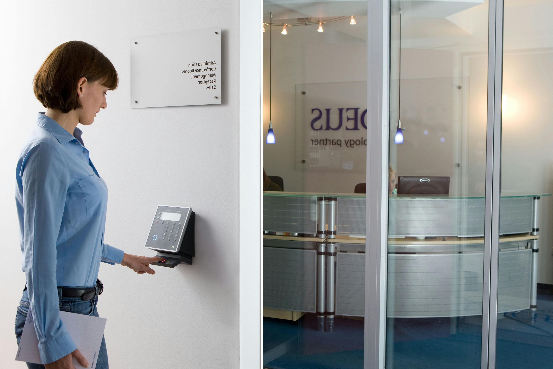
What We Offer
Fingerprint Scanners
High-accuracy and affordable fingerprint scanners for office access, office room doors, and restricted areas.
Face Scanners
Contactless 3D face scanners, which are highly secured and more accurate. Therefore, this is the popular choice between corporations.
Iris Scanners
Quick, accurate, and difficult to forge, this is a faster way of authentication, which makes it efficient and reliable at the same time.

Slide 8



BENEFITS FOR YOUR COMPANY
ONE TIME INVESTMENT
1 YEAR RETURN POLICY
Security
Since we are offering free installation service and free maintenance for the life, it will be a one-time investment for you. You just have to pay for the hardware (software is included in it).
If you do not like our product, you just have to fill out a form and follow a procedure. We will return your money.
(Condition applied: the product should not be damaged.)
Since we are using block chain technology in our hardware products, it is more secure than any other product that is available in the market. Nobody can encrypt and decrypt your data other than the user.

Slide 9
Our competition in the market
BioSecure
Competitors
Our hardware is budget-friendly without compromising the quality, and there are no hidden costs.
We support free first-time setup, and our devices are user-friendly.
We offer 24/7 customer support with a responsive team, but the best part about it is it's totally free!
Our competitors offer the same service as us but at a higher price, not to mention the hidden costs.
Our competitors will charge you for the first-time setup and their devices are hard to maintain.
Our competitors might charge you for future support, and they might take a while to respond to you.

Slide 10
How to proceed?
Discount
Contact
advantage
We are providing an exclusive discount for a limited time.
The amount of discount is 20%, so hurry up before time runs out.
Feel free to reach out today at
customerservice@biosecure.com
We will reply in one business day.
The sooner you get our service, the faster you will secure your data.
Say bye to data breaches!

Slide 11
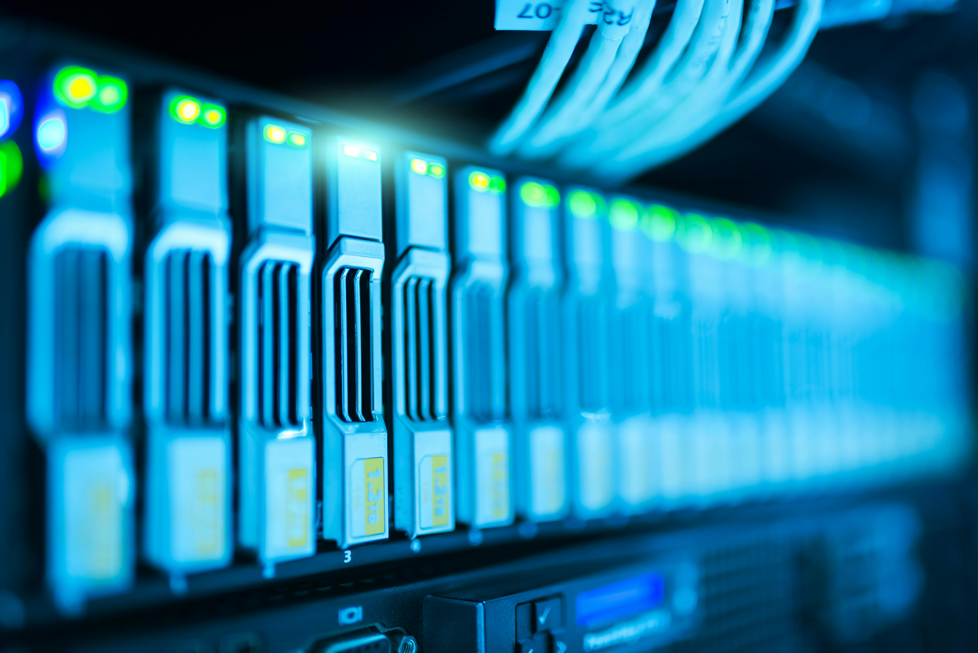
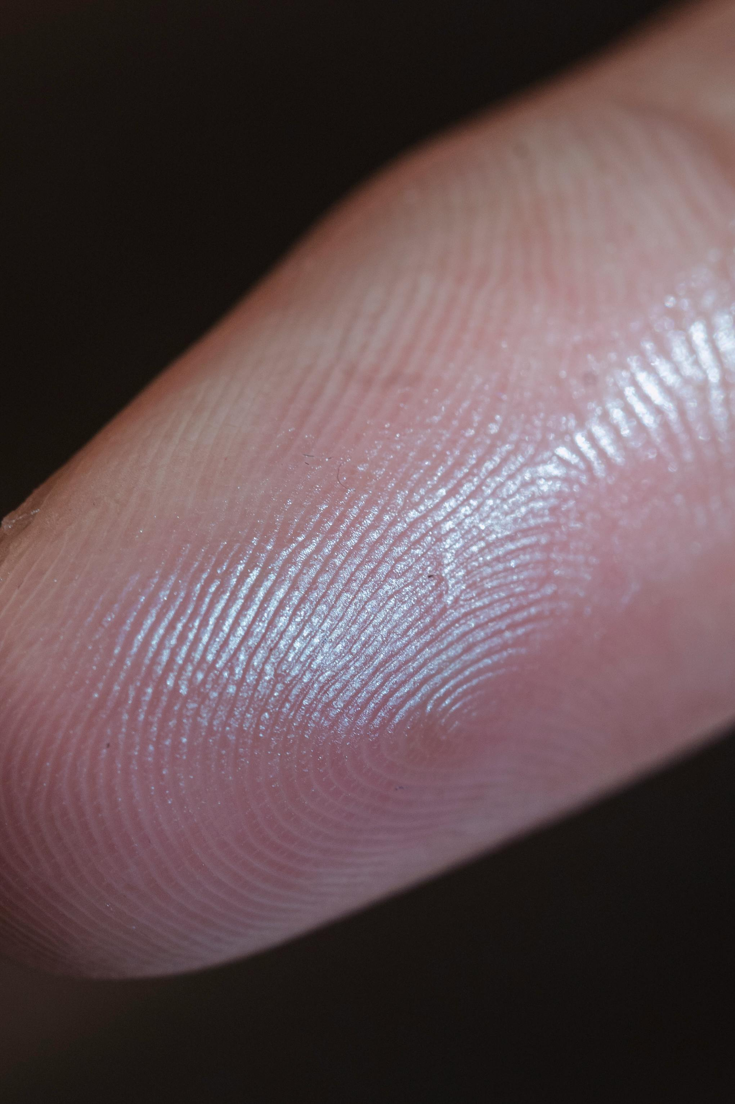
Thank you

